Slide 1
Red-Teaming and Cyber Risk Assessment at Sandia
Taylor McKenzie
Notes:
Good morning. I’m Taylor McKenzie and today I’ll be talking to you about red-teaming in particular and risk and resilience quantification in general at Sandia National Labs.

Slide 2
Background
Received Ph.D. in Economics from the University of Oregon in 2017
Focus in industrial organization and econometrics
Efficiency analyses (technical and allocative)
Structural modeling of pricing and economies of scale
Experience interning at Pacific Northwest National Laboratory
Disease modeling
Nuclear proliferation pathway analysis
Social media analytics
Social network analysis for cyber vulnerabilities
Currently a Senior Cybersecurity Researcher at Sandia National Laboratories
Risk and resilience analyses
Statistical analyses for variety of projects
Notes:
First, for some of my background. I received my Ph.D. in Economics about a couple of years ago from the University of Oregon. There, I focused on econometrics and industrial organization, performing structural analyses of efficiency, competition, and pricing.
Around that time I also interned at Pacific Northwest National Lab, starting off with disease modeling and nuclear proliferation pathway analysis, then working my way into more cyber-focused research topics.
I am now a senior cybersecurity researcher at Sandia National Labs, though the work I’ve done has been more diverse than the title would indicate. I have primarily worked on quantifying and analyzing risk posed to and the resilience of both cyber and non-cyber systems. I’ve also delved into statistical analyses supporting risk and resilience quantification for a number of projects, and I’ll speak to some of those later.

Slide 3
Outline
Risk, resilience, and vulnerability analysis
Red-teaming and the Sandia’s process
How we approach vulnerability analysis
Limitations of our approach and what we’ve done to address customer needs (blue slides)
Lessons learned

Slide 4
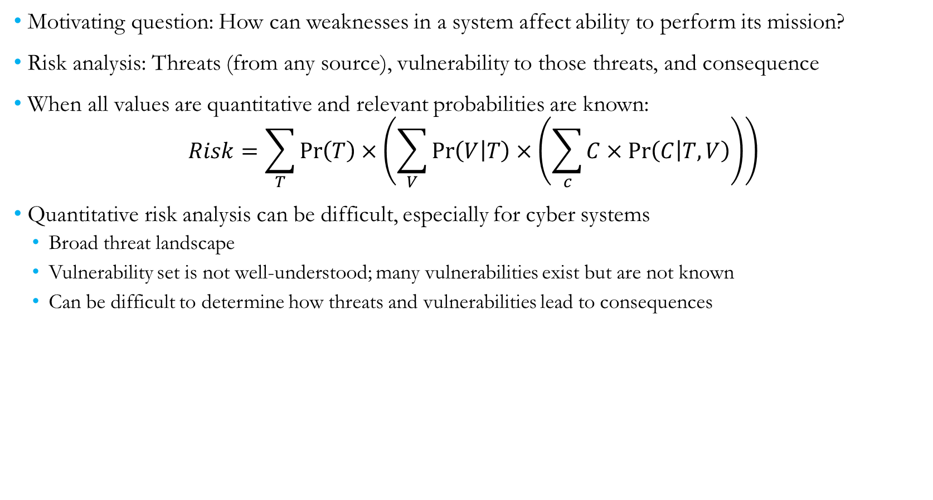
Risk, Resilience, and Vulnerability Analysis
Motivating question: How can weaknesses in a system affect ability to perform its mission?
Risk analysis: Threats (from any source), vulnerability to those threats, and consequence
When all values are quantitative and relevant probabilities are known:
$$Risk=\sum_{T}{\operatorname{Pr}\left(T\right)×\left(\sum_{V}{\operatorname{Pr}\left(V | T\right)×\left(\sum_{c}{C×\operatorname{Pr}\left(C | T,V\right)}\right)}\right)}$$
Quantitative risk analysis can be difficult, especially for cyber systems
Broad threat landscape
Vulnerability set is not well-understood; many vulnerabilities exist but are not known
Can be difficult to determine how threats and vulnerabilities lead to consequences
Notes:
When thinking about risk and resilience, the primary question we’re interested in answering is how weaknesses or other characteristics of a system might affect its ability to perform its mission.
For traditional risk analysis, we would consider threats emerging from any source, vulnerabilities those threats may be able to exploit, and consequences that would subsequently arise. Risk can be difficult to quantify for some systems, especially cyber systems, for a few reasons: (1) The threat landscape is very broad, with agents that possess a wide array of skills and motivations for causing a disruption; (2) The set of vulnerabilities is not well-understood (e.g., existence of vulnerabilities that are currently unknown); (3) It is not clear and very uncertain how threats and vulnerabilities propagate to consequences (depends on adversarial knowledge of the system, motivation, etc.)
Resilience analysis addresses difficulties in traditional risk analysis by conditioning on a specific threat (and sometimes vulnerability) and finding what consequences can arise. Resilience analysis typically takes the premise that all systems are vulnerable, and focuses on improving the system’s ability to withstand and quickly recover from a disruption.
Vulnerability analysis takes a sort of converse approach as resilience analysis, and focuses on specific consequences of concern and identifies vulnerabilities that could lead to those consequences. Those vulnerabilities can then be patched/improved, making the consequences of concern more costly/difficult to achieve.

Slide 5
Risk, Resilience, and Vulnerability Analysis
There are several alternative methods to address difficulties with quantitative risk analysis
Resilience analysis: Vulnerability to a specific threat and resulting consequences; focus on system’s ability to withstand and quickly recover from disruption
Vulnerability analysis: Specific consequence of concern and vulnerabilities that can lead to that consequence
Qualitative risk analysis: Score threat, vulnerability, and consequence on a qualitative scale; develop method to combine qualitative scores into overall risk
Useful when some information is available, but not enough to use quantitative risk framework
Notes:
When thinking about risk and resilience, the primary question we’re interested in answering is how weaknesses or other characteristics of a system might affect its ability to perform its mission.
For traditional risk analysis, we would consider threats emerging from any source, vulnerabilities those threats may be able to exploit, and consequences that would subsequently arise. Risk can be difficult to quantify for some systems, especially cyber systems, for a few reasons: (1) The threat landscape is very broad, with agents that possess a wide array of skills and motivations for causing a disruption; (2) The set of vulnerabilities is not well-understood (e.g., existence of vulnerabilities that are currently unknown); (3) It is not clear and very uncertain how threats and vulnerabilities propagate to consequences (depends on adversarial knowledge of the system, motivation, etc.)
Resilience analysis addresses difficulties in traditional risk analysis by conditioning on a specific threat (and sometimes vulnerability) and finding what consequences can arise. Resilience analysis typically takes the premise that all systems are vulnerable, and focuses on improving the system’s ability to withstand and quickly recover from a disruption.
Vulnerability analysis takes a sort of converse approach as resilience analysis, and focuses on specific consequences of concern and identifies vulnerabilities that could lead to those consequences. Those vulnerabilities can then be patched/improved, making the consequences of concern more costly/difficult to achieve.

Slide 6
Qualitative Risk Assessment: Prioritizing Improvements
The Cyber Security Advisor (CSA) group under the Department of Homeland Security performs cybersecurity assessments with the goal of improving security measures for high-risk organizations
CSA has relatively limited resources, wanted a method and tool to prioritize engagements (conferences, industry working groups, etc.)
We focused on measuring cyber risk posed to organization and the likelihood that engagements will lead to eventual assessments
Notes:
Was going to put CSA here, but would fit better in overall risk quantification

Slide 7
Qualitative Risk Assessment: Prioritizing Improvements
Likelihood of successful engagement could be assessed quantitatively using historical engagement data
Some problems with endogeneity and separating effects (e.g., is an advisor particularly successful, or do most engagements with a particular industry lead to assessments?)
Relied on qualitative measures of threat, vulnerability, and consequence
Some intuition on types of targets adversaries would target, vulnerabilities present, and potential impacts
Example: Larger organizations face higher threat and greater consequence than smaller organizations
Developed initial method of combining measures into overall risk
Polled CSA with hypothetical engagements, asked them to score each component and overall risk
Used for improving and validating methodology
Notes:
Was going to put CSA here, but would fit better in overall risk quantification

Slide 8
Vulnerability Analysis and Red Teaming
Vulnerability analysis often takes the form of red teaming
Red teaming: Assuming the role of an adversary to identify vulnerabilities and their consequence
There are many flavors of red teaming
Sandia’s main red teaming effort is unique in a few ways
Information Design Assurance Red Team (IDART)
Considers a realistic adversary for a given target
An adversary would not launch a sophisticated attack to break into your home wireless network
Considers a realistic attack path, including a combination of cyber and physical actions
Why do something the hard way?
Documents the process and areas of improvement
Notes:
Key points:
Many red teams hit a target with relatively sophisticated attacks (regardless of the target), focus solely on one vector (e.g., cyber), and only aim to break into the system (not show how it was done or what could be done generally to improve)
Sandia focuses on developing rules of engagement
Reference for IDART
Red teaming, where an assessor takes the role of an adversary to identify vulnerabilities and consequences, is a common form of vulnerability analysis.
There are many types of red-teaming that take various approaches on vulnerability identification. Sandia’s main red-teaming effort, called the Information Design Assurance Red-Team (or IDART), differentiates itself in a few ways.
First, many red teams will use whatever method they can to achieve a given consequence. For many systems, this results in an attack that would be much more sophisticated than a realistic adversary would actually pursue. For example, an adversary would not launch an extremely sophisticated attack just to break into your home wireless network (depends on who you are, but not very likely); the cost is too high relative to the payoff, and a method requiring less effort/resources could probably achieve a similar result. IDART uses an generalized adversarial model to consider the abilities and motivations of an adversary that would be likely to attack the system of interest.
Second, in a similar vein, many red teams focus solely on one attack vector (typically cyber). In our adversarial model, we assume the adversary will take the path that is lowest effort and least detectable, which may include both cyber and physical actions.
Finally, (and there has been some improvement in this), but other red teams have a tendency to just show a system can be broken into, and don’t document their process or improvements that could be made. IDART focuses heavily on providing complete documentation and identifying improvements that could be made (and priority for those improvements).

Slide 9
IDART Process
Identify consequences of concern (nightmare scenarios)
Define a model of a realistic adversary, including skills and tolerance for risk
Collect information about the system, including potential weaknesses and attack vectors
Identify and document easiest (low effort, low likelihood of detection) attack paths that result in consequences of concern
(Optional) Demonstrate attack paths to show feasibility
Notes:
For the rest of this talk, I’m going to walk through a high-level overview of IDART’s process. The process includes first identifying consequences the customer is concerned about, then the adversarial model is defined. Relevant information about the system is collected and then used to identify potential realistic attack paths that could result in the consequences of concern. Finally, to show the attack is feasible (and to show its actual difficulty) we will often perform a demonstration for the customer.
As I walk through these steps, I will also be highlighting some of the ways this methodology doesn’t always meet our customers’ needs and other methods we’ve used to better address those concerns.

Slide 10
IDART Process
Identify consequences of concern (nightmare scenarios)
Define a model of a realistic adversary, including skills and tolerance for risk
Collect information about the system, including potential weaknesses and attack vectors
Identify and document easiest (low effort, low likelihood of detection) attack paths that result in consequences of concern
(Optional) Demonstrate attack paths to show feasibility
Notes:
First, I’ll be discussing how we identify consequences of concern.

Slide 11
Nightmare Consequences
What consequences can the customer absolutely not tolerate?
Advantages:
Impacts are clear and understandable to the decision-maker
Improving vulnerabilities that lead to high-consequence impacts can have greatest return
Can be easier to identify and explain attack paths that result in high-consequence outcomes
Disadvantages:
There can be other consequences that are high-impact but not “the worst thing that can happen”
High-impact consequences the customer is less familiar with may be overlooked

Slide 12
Categorizing Consequences
It can be helpful to categorize consequences to identify potential attack paths
For information systems, consequences/capabilities measured in terms of¹
Confidentiality: Ability to protect information from unauthorized access
Integrity: Ability to protect information from unauthorized changes
Availability: Ability to provide access to system or services when requested
(Less frequently) Accountability/non-repudiation: Ability to track actions on a system and associate them with specific actors²
(Less frequently) Assurance: Ability to trust metrics and system analysis to ensure it performs its mission
Nightmare consequence examples
Systems that store personal information: Confidentiality
Power system: Availability
Power system information/control infrastructure: Integrity and Availability
1. See Stoneburner, Gary, Clark Hayden, and Alexis Feringa. Engineering principles for information technology security (a baseline for achieving security). Booz-Allen and Hamilton Inc Mclean VA, 2001.
2. For example, see RAND Report 2395: Olympic-Caliber Cybersecurity
Notes:
Power system: Integrity; spoofing system state or changing SCADA commands (e.g., generator set point)
Add in 2001 reference from RAND report
Confidentiality: OPM breach
Power system availability: NERC issued $10 million in fines due to Duke Energy’s cyber risk
As I mentioned before, IDART primarily focuses on systems that store, process, and transmit information. For those information systems, consequences are most frequently measured in terms of what’s called the “CIA triad”, which was laid out in a seminal NIST report by Stoneburner in 2001. That includes confidentiality, which is the ability to protect information from unauthorized access, integrity, which is the ability to protect information from unauthorized changes, and availability, which is the ability to provide access to the system or services provided by the system on demand.
There are also two other categories that don’t necessarily affect the ability of a system to operate, but are important in how the system functions in a more abstract sense. First is accountability, which is also called non-repudiation. This is the ability to track actions performed on a system and attribute them to specific actors. While this doesn’t affect the ability of the information system to store, process, or transmit information, it does aid in strategic and deterrence capabilities because it allows adversaries to be identified and retaliatory actions to be taken. The RAND report “Olympic-Caliber Cybersecurity” describes the importance of accountability to the cybersecurity of the upcoming Olympic games in Tokyo; if a cyber-attack does occur, it will be crucial to identify the source and provide incontrovertible evidence to the national community so that appropriate counter-actions can be taken. When this ability is widely communicated, it creates a credible threat that can enhance deterrence of cyber-attacks.
Finally, assurance is the ability to trust all of above metrics and system analysis behind those metrics to ensure the system can perform its mission when it needs to. This metric frequently takes the form of sensitivity analysis and uncertainty quantification, and while it’s not necessarily a factor that is looked at directly, it often implicitly makes it way into the analysis.
In performing an IDART assessment, our first step is identifying consequences and outcomes that the customer absolutely cannot tolerate. After identifying those consequences, we categorize them into one of the above categories so we can better identify what types of attacks will result in those consequences. So for example, if you’re the owner of a system that stores personal information (like Equifax), you absolutely do not anyone without proper authorization to access that data; that is, you want to protect the confidentiality of that data and your system. The focus of may change based on what aspects of the system we are considering. For example, the primary objective of a power system as a whole is to reliably provide electricity when it is demanded, which is an availability issue. However, the power system and information and control infrastructure aims to measure the state of the system and send control commands based on that system state; integrity plays a much larger part in that subsystem because it is crucial that system readings are unbiased and that commands issued are the same as commands received (that is, no one is providing fake readings or altering control commands).

Slide 13
Consequences More Generally
For other projects/applications, we want to quantify consequence impact beyond “the worst thing that can happen”
These consequences may be less understood by decision-makers (e.g., system-level impacts)
It may be difficult to determine exactly how consequences propagate
It can be difficult/impossible to numerically quantify consequences, necessitating qualitative measures
Involved in a few projects that dealt with these issues
Notes:
More than just nightmare scenarios, want to quantify consequence for any threat/vulnerability.
Can be done quantitatively if data exist
Can also be done qualitatively (as in CSA or NETCOM project).
For NETCOM, we categorized low-level metrics then determined how those mapped into CIA for the system as a whole.
For CSA, we categorized based on industry.
Now, while IDART focuses on the worst consequences that can happen (which is often useful because those consequences are often feasible given how customers set up their systems), there are other applications where we want to quantify the impact of all consequences that can result from a given threat and vulnerability. As alluded to before, there are some difficulties in doing this generally.
First, nightmare consequences are relatively easy for a decision-maker to understand; if those happen, they could expect to get a phone call in the middle of the night or would have to cut a vacation short. They are outcomes that would have to be responded to immediately and could result in the loss of money, loss of the decision-maker’s job, or even loss of life. Other consequences, on the other hand, may be more nuanced and difficult for the decision-maker to understand; for example, these might be more technical system-level impacts, and I’ll have an example of some of these outcomes in the next slide. Given that those consequences may be difficult to comprehend, we may try to propagate them through the system to something the decision-maker can understand; however, performing that propagation can be difficult and very uncertain, making those aggregated measures less useful. It can even get to the point where it’s not really feasible to quantitatively measure those impacts, and we end up having to rely on qualitative measures, and to do that we need some sort of way to come up with qualitative measures and give them meaningful interpretations.
I’ve been involved with a few projects at Sandia that have aimed to do this general consequence quantification.

Slide 14
Projects Quantifying Consequence: Network simulation
Quantifying resilience of enterprise network to various cyber attacks
EmulyticsTM: Simulation of real cyber system with high fidelity
Ability to simulate individual components, interaction between components
Ability to plug in real hardware
See how the system would respond to a disruption without affecting real operations
Able to simulate network and observe system-level values (e.g., latency, connectivity, uptime)
Included hosts (e.g., running Windows and additional software), servers, communications
Tested various disruption scenarios: Denial of service, random/systematic outages
Some problems:
System-level values are noisy
Decision-makers need higher-level information
Difficult to understand exactly how system-level impacts affect ability to perform mission
Notes:
In one such project we were tasked with quantifying the resilience of an enterprise network to various cyber attacks. The effort began by leveraging a capability at Sandia called “emulytics”, which allows us to simulate a real cyber system with high fidelity. This includes the ability to simulate individual components of a system and their interactions, and even allows us to plug hardware into the simulation so that we can have the most accurate view of the system as possible. We can then tests various attacks and disruptions against the simulated system to see how the real system would respond without actually affecting the operations of the real system.
For this project, we created a number of virtual host machines running Windows and various software, including mail, chat, and file transferring services; we then connected them all to a network and simulated communications between each of hosts, creating what was ostensibly an accurate representation of their network. Using that simulation, we then hit the system with low-level consequence representing several classes of cyber attacks and other disruptions. For example, we added artificial requests to servers from an external source to simulate a denial of service attack; routers and hosts were both randomly and systematically turned off to simulate random outages and an attack targeting availability, respectively. We were able to see how system-level values were affected, such as latency of communication across the network, ability for hosts and servers to connect, and uptime of services provided through the network. Now, these system level data presented a few problems. First, those system-level values are very noisy, potentially making it difficult to identify effects of a disruption from raw data (which is what analysts were doing at the time). Second, decision-makers needed higher-level information, specifically how attacks and disruptions affected the ability of the system to perform its mission. Finally, it was very difficult to discern mission-level impacts from raw system-level data.
The approach we took involved two steps. First, to address the noisy data, I performed some state estimation to get to the true value of some quantities of interest. We felt that the ability of the system to perform its mission was going to be primarily affected by the ability of hosts to communicate with servers and with each other, and the time it took for communications to get from point A to point B. So, we were interested in, for example, the probability that a given host would be able to communicate with a given server, and how long the back-and-forth could be expected to take. Our initial simulation assumed traffic was independent, which made the estimation much easier, but we also developed some ideas to accommodate dependencies in traffic if and when that data started being used.
The second step involved converting the system-level metrics to higher levels that would be understandable to a decision-maker. Ultimately we decided to break the overall system down into the services and capabilities it provided, and develop a mapping of system-level metrics into measures of confidentiality, integrity, and availability for each of those services. We created that mapping by deliberating within our team and with people familiar with the system so that, for example, we could determine what latency and connectivity were needed so that the availability of the mail service was at an acceptable level. We then took those service attributes and aggregated them into the ability to perform broader actions, like communicating with a coworker (whether that be through email, chat, or some other medium).

Slide 15
Projects Quantifying Consequence: Network simulation
Performed state estimation to estimate true quantities of interest
Aimed to describe ability of hosts to communicate with servers and each other
Example: If a given host made a request to a given server, with what probability could it expect the response is received? How long could the host expect to wait for a reply?
Deliberated with team and people familiar with system to convert system-level metrics to higher levels
Measures of confidentiality, integrity, and availability for services/capabilities provided by system
Measures of ability to perform specific actions given system attributes
Notes:
In one such project we were tasked with quantifying the resilience of an enterprise network to various cyber attacks. The effort began by leveraging a capability at Sandia called “emulytics”, which allows us to simulate a real cyber system with high fidelity. This includes the ability to simulate individual components of a system and their interactions, and even allows us to plug hardware into the simulation so that we can have the most accurate view of the system as possible. We can then tests various attacks and disruptions against the simulated system to see how the real system would respond without actually affecting the operations of the real system.
For this project, we created a number of virtual host machines running Windows and various software, including mail, chat, and file transferring services; we then connected them all to a network and simulated communications between each of hosts, creating what was ostensibly an accurate representation of their network. Using that simulation, we then hit the system with low-level consequence representing several classes of cyber attacks and other disruptions. For example, we added artificial requests to servers from an external source to simulate a denial of service attack; routers and hosts were both randomly and systematically turned off to simulate random outages and an attack targeting availability, respectively. We were able to see how system-level values were affected, such as latency of communication across the network, ability for hosts and servers to connect, and uptime of services provided through the network. Now, these system level data presented a few problems. First, those system-level values are very noisy, potentially making it difficult to identify effects of a disruption from raw data (which is what analysts were doing at the time). Second, decision-makers needed higher-level information, specifically how attacks and disruptions affected the ability of the system to perform its mission. Finally, it was very difficult to discern mission-level impacts from raw system-level data.
The approach we took involved two steps. First, to address the noisy data, I performed some state estimation to get to the true value of some quantities of interest. We felt that the ability of the system to perform its mission was going to be primarily affected by the ability of hosts to communicate with servers and with each other, and the time it took for communications to get from point A to point B. So, we were interested in, for example, the probability that a given host would be able to communicate with a given server, and how long the back-and-forth could be expected to take. Our initial simulation assumed traffic was independent, which made the estimation much easier, but we also developed some ideas to accommodate dependencies in traffic if and when that data started being used.
The second step involved converting the system-level metrics to higher levels that would be understandable to a decision-maker. Ultimately we decided to break the overall system down into the services and capabilities it provided, and develop a mapping of system-level metrics into measures of confidentiality, integrity, and availability for each of those services. We created that mapping by deliberating within our team and with people familiar with the system so that, for example, we could determine what latency and connectivity were needed so that the availability of the mail service was at an acceptable level. We then took those service attributes and aggregated them into the ability to perform broader actions, like communicating with a coworker (whether that be through email, chat, or some other medium).

Slide 16
IDART Process
Identify consequences of concern (nightmare scenarios)
Define a model of a realistic adversary, including skills and tolerance for risk
Collect information about the system, including potential weaknesses and attack vectors
Identify and document easiest (low effort, low likelihood of detection) attack paths that result in consequences of concern
(Optional) Demonstrate attack paths to show feasibility
Notes:
This brings us to the second step of the IDART process, which is defining a model of a realistic adversary.

Slide 17
Adversary Models: Generic Threat Matrix
For IDART, hypothetical adversaries are qualitatively rated along six attributes
Intensity: Risk tolerance for getting caught and negative consequences
Stealth: Ability to maintain secrecy through attack
Time: Amount of resources (including time) adversary is willing to spend planning, developing, and deploying attack
Technical personnel: Size of technical team
Knowledge: Level of cyber and other knowledge possessed by adversary
Access: Ability to access facility or system, either by opportunity, force/coercion, or insider assistance
Attribute ratings are then aggregated into an overall adversary level using the generic threat matrix (1-High, 8-Low)
This is a subjective, deliberative process, often end up with more than one possible categorization
This process is based on SAND Report 2007-5791: Categorizing Threats
Reviews actual attacks and characteristics of real adversaries
Develops abstract method of categorizing threats that can be used openly
Notes:
Currently working to develop more rigorous adversary models using SME survey data
For the purposes of IDART, hypothetical adversaries are qualitatively scored along six dimensions. First, the intensity of an adversary measures their risk tolerance for getting caught and any negative consequences they might incur. Stealth measures the ability of the adversary to maintain secrecy through an attack. Time, which isn’t quite aptly named, is the amount of resources an adversary is willing to spend to plan, develop, and deploy an attack. Technical personnel is the size of the adversary’s technical team. Knowledge is the level of cyber and potentially other knowledge (like physical intrusion capabilities) possessed by the adversary. Finally, access is the adversary’s ability to access a facility or system, either by opportunity, by force or by coercing members of the organization, or by using an insider.
We typically score our hypothetical adversary along each of these dimensions, then

Slide 18
Generic Threat Matrix
Threat Level | Threat Profile
 | Commitment |  |  | Resources
 | Intensity | Stealth | Time | Technical Personnel | Knowledge |  | Access
 |  |  |  |  | Cyber | Kinetic
1 | H | H | Years to Decades | Hundreds | H | H | H
2 | H | H | Years to Decades | Tens of Tens | M | H | M
3 | H | H | Months to Years | Tens of Tens | H | M | M
4 | M | H | Weeks to Months | Tens | H | M | M
5 | H | M | Weeks to Months | Tens | M | M | M
6 | M | M | Weeks to Months | Ones | M | M | L
7 | M | M | Months to Years | Tens | L | L | L
8 | L | L | Days to Weeks | Ones | L | L | L

Slide 19
Adversary Models: Aggregation
Why use an aggregate skill level rather than ratings for each attribute?
Attribute scores are correlated in real-world adversaries, aggregating ensures hypothetical adversary is more realistic
Avoids overfitting adversary characteristics
Easier to quickly evaluate attack path difficulties and determine whether the path is feasible to a given adversary
Disadvantages:
Scoring and aggregation can collapse skill sets (e.g., compromising two similar vulnerabilities requires less skill/resources than compromising two very different vulnerabilities)
Subjective, may not rely directly on subject matter expertise

Slide 20
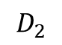
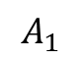
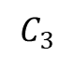
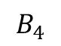
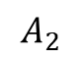
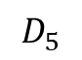
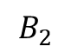
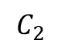
Analysis to Select Adversarial Model
We have been working to make this process less subjective, taking our deliberation out of the process, and relying more on subject matter expertise
For physical systems, we have surveyed subject matter experts over a variety of dimensions/capabilities to determine what is required to overcome given security measures
We have taken a couple approaches to using this data
Example data: Security measures indexed by letters, experts indexed by subscripts
Skill 1
$$A_{1}$$
$$A_{2}$$
$$B_{4}$$
$$B_{2}$$
Skill 2
$$C_{2}$$
$$C_{3}$$
$$D_{2}$$
$$D_{5}$$
Notes:
Point of this slide:

Slide 21
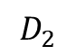
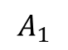
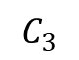
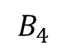
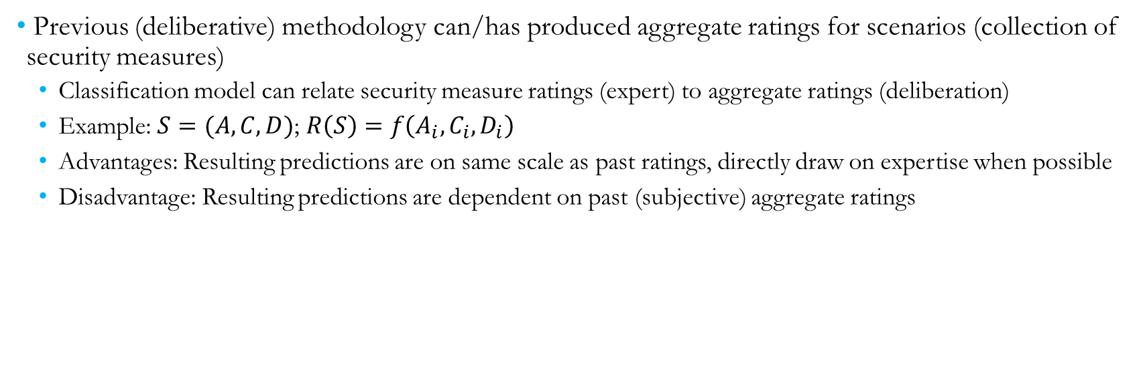
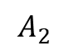
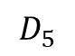
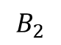
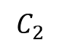
Security Measure Rating Example
Skill 1
$$A_{1}$$
$$A_{2}$$
$$B_{4}$$
$$B_{2}$$
Skill 2
$$C_{2}$$
$$C_{3}$$
$$D_{2}$$
$$D_{5}$$
Previous (deliberative) methodology can/has produced aggregate ratings for scenarios (collection of security measures)
Classification model can relate security measure ratings (expert) to aggregate ratings (deliberation)
Example: $S=(A, C, D)$; $R\left(S\right)=f\left(A_{i},C_{i},D_{i}\right)$
Advantages: Resulting predictions are on same scale as past ratings, directly draw on expertise when possible
Disadvantage: Resulting predictions are dependent on past (subjective) aggregate ratings
Notes:
Point of this slide:

Slide 22
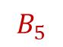
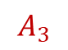
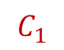
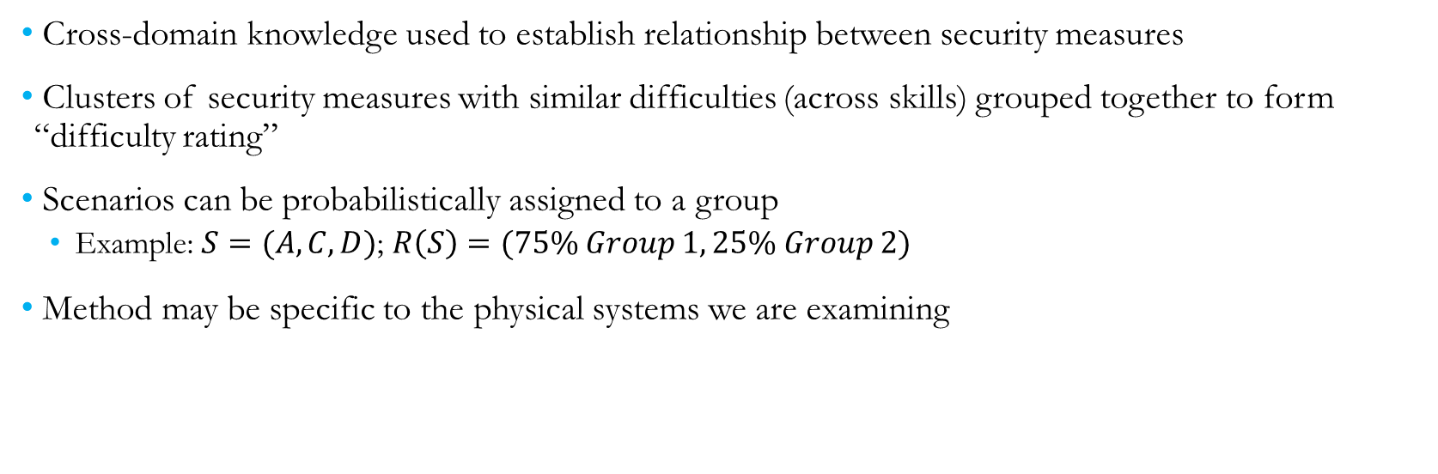
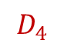
Security Measure Rating Example
Skill 1
$$A_{1}$$
$$A_{2}$$
$$A_{3}$$
$$B_{4}$$
$$B_{2}$$
$$B_{5}$$
Skill 2
$$C_{1}$$
$$C_{2}$$
$$C_{3}$$
$$D_{4}$$
$$D_{2}$$
$$D_{5}$$
Cross-domain knowledge used to establish relationship between security measures
Clusters of security measures with similar difficulties (across skills) grouped together to form “difficulty rating”
Scenarios can be probabilistically assigned to a group
Example: $S=(A, C, D)$; $R\left(S\right)=(75\% Group 1, 25\% Group 2)$
Method may be specific to the physical systems we are examining
Notes:
Point of this slide:

Slide 23
IDART Process
Identify consequences of concern (nightmare scenarios)
Define a model of a realistic adversary, including skills and tolerance for risk
Collect information about the system, including potential weaknesses and attack vectors
Identify and document easiest (low effort, low likelihood of detection) attack paths that result in consequences of concern
(Optional) Demonstrate attack paths to show feasibility

Slide 24
System Information and Weaknesses
Approach: Tour facility, gain as much knowledge of the system as possible, document
Key takeaway: There are frequently differences between how people think a system is configured vs. how it is actually configured
Misunderstanding of terms
Outdated system information
Plan vs. implementation
Asking the right questions, asking in several different ways
Examples:
“Our system is air-gapped”
How do you update software on your system?
Can employees check their personal email? How do you read the news?
Is the same account information used on internal (air-gapped) and external (not air-gapped) networks?
Network diagram vs. network map results

Slide 25
IDART Process
Identify consequences of concern (nightmare scenarios)
Define a model of a realistic adversary, including skills and tolerance for risk
Collect information about the system, including potential weaknesses and attack vectors
Identify and document easiest (low effort, low likelihood of detection) attack paths that result in consequences of concern
(Optional) Demonstrate attack paths to show feasibility

Slide 26
Attack Paths
Key assumption: An adversary will not do something difficult or easily detectable if the same result can be accomplished by doing something easy or less detectable
Example: Produce/procure identical badge and insert credentials into system OR create a look-alike, dress as staff, and ask someone to let you in
Basic strategy
Find a large open wall and post-its
Starting points on one side, nightmare consequences on the other
Brainstorm steps at any point in the attack sequence based on ideas/expertise
Prune steps that are too difficult for adversary model or more difficult than other steps that accomplish same result
Chain together steps to create attack path
Detailed and complete information about the system is critical
May require some iteration
Notes:
Physical and cyber actions

Slide 27
IDART Process
Identify consequences of concern (nightmare scenarios)
Define a model of a realistic adversary, including skills and tolerance for risk
Collect information about the system, including potential weaknesses and attack vectors
Identify and document easiest (low effort, low likelihood of detection) attack paths that result in consequences of concern
(Optional) Demonstrate attack paths to show feasibility

Slide 28
Demonstrating Attack Paths
Main goal: Show it’s possible to make a nightmare consequence happen under the adversarial model
Showmanship/cool factor never hurts
Many customers think attacks need to be sophisticated
Systems are secured against sophisticated attacks, leave open easier attack paths
Showing them an attack can be easy gets them thinking other low-hanging fruit
We like to perform assessments in design phase; red-team mentality becomes ingrained in design process
We’re happy to help identify vulnerabilities, but we like to teach customers to think about potential system weaknesses on their own

Slide 29
Lessons Learned
Real-life security measures are often not as advanced as expected
Attacks do not need to be sophisticated to be successful
Security measures tend to focus on one area, leaving open other attack vectors
Often not a question of if a system will be compromised, but when; importance of resilience
Frequent differences between ideas of system configuration and actual configuration
Quantitative risk analysis can be difficult or infeasible
Highlighting vulnerabilities is more approachable and can achieve similar operational goals
Other analyses (e.g., resilience analysis) can be useful for other scenarios
Notes:
Triton

